Slide 1
Week 4
Data Cleaning and Manipulation
(Groupby , Pivot Tables, Common Errors and Fixes)

Slide 2
Introduction to GroupBy
GroupBy is a powerful feature in Pandas that allows you to split data into groups based on one or more columns, apply operations to each group independently, and then combine the results. It follows the "split-apply-combine" strategy.
Example: Grouping students by grade level and then calculating the average score for each grade.
Example: Finding average house price per suburb
Syntex : df.groupby("Suburb")["Price"].mean()

Slide 3
Comparison of Groupby in Python and Excel
Comparison with Excel:
df.groupby("Suburb")["Price"].mean() ➝ Similar to Excel Pivot Table's Average Function
df.groupby(["Suburb", "Type"])["Price"].sum() ➝ Similar to SUMIFS in Excel

Slide 4
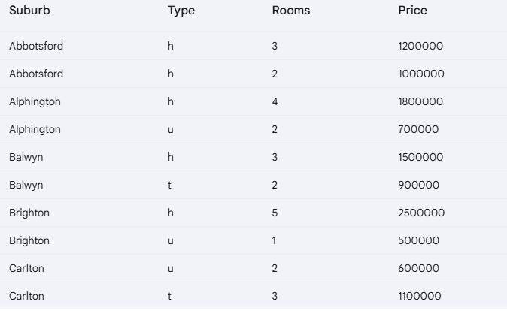
Before Groupby

Slide 5
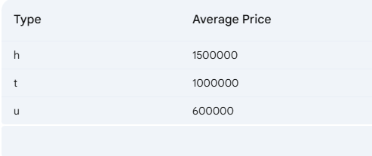
After Groupby “Type”
Notes:
(h = house, t = townhouse, u = unit)
GroupBy Operation:
We want to group this data by the "Type" column and calculate the average "Price" for each property type.
Result of GroupBy:
TypeAverage Price h1500000, t 1000000, u 600000
Explanation:
Split: The data is split into three groups based on the unique values in the "Type" column: 'h', 't', and 'u'.
Apply: The mean() function (average) is applied to the "Price" column within each group.
Combine: The results (the average prices) are combined into a new table, where the "Type" becomes the index (or group label), and the "Average Price" is the calculated value.

Slide 6
Explanation:
Split: The data is split into three groups based on the unique values in the "Type" column: 'h', 't', and 'u'.
Apply: The mean() function (average) is applied to the "Price" column within each group.
Combine: The results (the average prices) are combined into a new table, where the "Type" becomes the index (or group label), and the "Average Price" is the calculated value.

Slide 7
Aggregation Functions
Aggregation functions summarize numerical data into single values.
Common functions:
sum() – Total sum of values
mean() – Average value
count() – Number of non-null values
min() / max() – Minimum & Maximum values
median() – Middle value
std() – Standard deviation

Slide 8
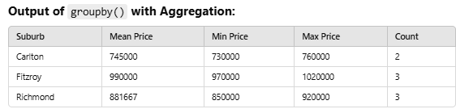
Using Aggregation Function with other common functions
df.groupby("Suburb")["Price"].agg(["mean", "min", "max", "count"])

Slide 9
Using Multiple GroupBy Keys
We can group by multiple columns for deeper insights.
Example: Grouping by Suburb & Rooms
Helps in multi-level analysis of grouped data.
Suburb (e.g., Richmond, Carlton)
Property Type (e.g., House, Apartment)
Rooms (e.g., 2, 3, 4)
Price (Property price)
df.groupby(["Suburb", "Rooms"])["Price"].mean()

Slide 10
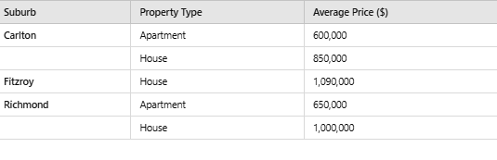
Multi-Level GroupBy Table (Mean Price by Suburb & Property Type)
Notes:
Carlton: Houses are more expensive than apartments.
Fitzroy: Only houses available, averaging 1.09M.
Richmond: Houses are significantly more expensive than apartments.

Slide 11
Introduction to Pivot Tables
What is a Pivot Table?
A tool for dynamic summarization of data.
Aggregates data based on different categories.
Useful in data reporting & business intelligence.
Example: Finding the average price per suburb
df.pivot_table(index="Suburb", values="Price", aggfunc="mean")

Slide 12
GroupBy vs. Pivot Tables in Pandas
Both Groupby and Pivot give similar output (not exactly same) but use different approaches
df.groupby(["Suburb", "Type"])["Price"].mean()
df.pivot_table(index="Suburb", columns="Type", values="Price", aggfunc="mean")

Slide 13
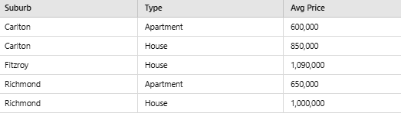
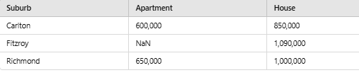
Groupby Output (creates a long-format table, great for numerical analysis.)
Pivot Output (creates a wider, spreadsheet-like table, useful for visualization & reports.

Slide 14
Handling Missing Values in Pivot Tables
Pivot tables can handle missing data using fill_value.
Example: Replacing missing values with 0
df.pivot_table(index="Suburb", values="Price", aggfunc="mean", fill_value=0)

Slide 15
Introduction to Cross-Tabulation
pd.crosstab() computes frequency tables across categories.
Helps analyze relationships between categorical variables.
Example: Count the number of properties per suburb & type

Slide 16
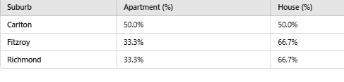
Percentage-Based Cross-Tabulation of Suburb vs. Property Type

Slide 17
Interpretation and Uses
Interpretation:
Carlton has an equal split (50% Apartments, 50% Houses).
Fitzroy & Richmond have more Houses (66.7%) than Apartments (33.3%).
Useful for Market Analysis: Identifies which suburbs have more apartments vs. houses.
Why is this useful?
Market Segmentation: Helps in planning new property developments.
Business Insights: Property agencies can target areas based on property type demand.
Investment Decisions: Buyers can choose locations based on housing availability.

Slide 18
Some Advanced Python Concepts

Slide 19
Pip Install
This installs version 1.21.0 of the numpy library.
pip install is a command used to download and install Python packages from the Python Package Index (PyPI) or other repositories.
When to use it: You use pip install when you want to add a new library or package to your Python environment.
Where it runs: It is executed in the command line (terminal or command prompt), not in a Python script.
Example : pip install pandas (This command installs the pandas library so you can use it in your Python programs.)
!pip install pip install numpy==1.21.0 (Installs version 1.21.0 of the numpy library.)

Slide 20
Some more pip installs
This installs version 1.21.0 of the numpy library.
Install the Latest Version of a Package
pip install --upgrade pandas
Installing Multiple Packages
!pip install numpy pandas matplotlib seaborn

Slide 21
Import in Python
This installs version 1.21.0 of the numpy library.
I
Import
import is a Python keyword used to include and use a module or library in your Python script.
• When to use it: You use import in your Python code to access the functionality of a library or module that has already been installed.
• Where it runs: It is written inside a Python script or interactive Python session (e.g., Jupyter Notebook).
• Example: import pandas as pd

Slide 22
Google Colab comes with many popular Python libraries pre-installed (e.g., numpy, pandas, matplotlib, tensorflow, etc.), but if you need additional packages, you can install them using pip.

Slide 23
To check which libraries are installed in Colab !pip list

Slide 24
Aspect | pip install | import
Purpose | Installs a package or library from PyPI or another source. | Loads an installed package or module into your Python script.
Where it’s used | Command line (terminal or command prompt). | Python script or interactive session.
When to use it | When you need to install a new library or package. | When you want to use an already installed library or module in your code.
Example | pip install numpy | import numpy as np
Dependencies | Downloads and installs the package and its dependencies. | Assumes the package is already installed.
Scope | Affects the entire Python environment (global or virtual environment). | Affects only the current script or session where it is imported.

Slide 25
How Pip Install and Import Work Together
This installs version 1.21.0 of the numpy library.
Step 1: Install the Package
Use pip install to download and install the package.
Example: pip install matplotlib
Step 2: Import the Package
Use import to include the package in your Python script.
Example: import matplotlib.pyplot as plt

Slide 26
Common Errors and Fixes in pip
This installs version 1.21.0 of the numpy library.
Error: ModuleNotFoundError
Cause: The package is not installed in your environment.
Fix: Use pip install to install the missing package.
pip install <package_name>

Slide 27
Common Errors and Fixes in pip
This installs version 1.21.0 of the numpy library.
Error: ImportError
Cause: The package is installed, but there’s an issue with the import statement (e.g., incorrect module name).
Fix: Double-check the import statement and ensure the package is installed correctly.

Slide 28
Common Errors in Python Codes and Fixes

Slide 29
Why Understanding Errors is Important
Errors help identify issues in code.
Properly reading errors speeds up debugging.
Python provides clear error messages to guide fixes.

Slide 30
SyntaxError
Cause: Invalid Python syntax.
Example: print("Hello, World"
Error Message: SyntaxError: unexpected EOF while parsing

Slide 31
IndentationError
Cause: Incorrect indentation.
Example:
def greet():
print("Hello, World")
Error Message: IndentationError: expected an indented block
Fix: Indent the code block properly.

Slide 32
NameError
Cause: Using an undefined variable or function.
Example:
print(message)
Error Message: NameError: name 'message' is not defined
Fix: Define the variable before use.

Slide 33
TypeError
Cause: Operation on incompatible types.
Example:
result = "5" + 3
Error Message: TypeError: can only concatenate str (not "int") to str
Fix: Convert types appropriately.

Slide 34
IndexError
Cause: Accessing an invalid index in a sequence.
Example:
my_list = [1, 2, 3]
print(my_list[3])
Error Message:
IndexError: list index out of range
Fix: Ensure the index is within range.
print(my_list[-1])

Slide 35
KeyError
Cause: Accessing a non-existent dictionary key.
Example:
my_dict = {"name": "Alice"}
print(my_dict["age"])
Error Message:
KeyError: 'age'

Slide 36
AttributeError
Cause: Accessing a non-existent attribute or method.
Example:
my_list = [1, 2, 3]
my_list.appendx(4)
Error Message:
AttributeError: 'list' object has no attribute 'appendx'
Fix: Use the correct attribute or method.
my_list.append(4)

Slide 37
ValueError
Cause: Invalid value for an operation.
Example:
int("abc")
Error Message:
ValueError: invalid literal for int() with base 10: 'abc'
Fix: Ensure the value is valid for conversion.
int("123")

Slide 38
ImportError
Cause: Unable to import a module.
Example:
import non_existent_module
Error Message:
ImportError: No module named 'non_existent_module'
Fix: Install or check the module name.
pip install module_name

Slide 39
ZeroDivisionError
Cause: Division by zero.
Example:
result = 10 / 0
Error Message:
ZeroDivisionError: division by zero
Fix: Check for zero before dividing.
if denominator != 0:
result = 10 / denominator

Slide 40
Key Take aways:
Errors help in debugging and improving code.
Understanding error messages is crucial for efficient troubleshooting.
Regular practice makes debugging easier and faster.

